Slide 1
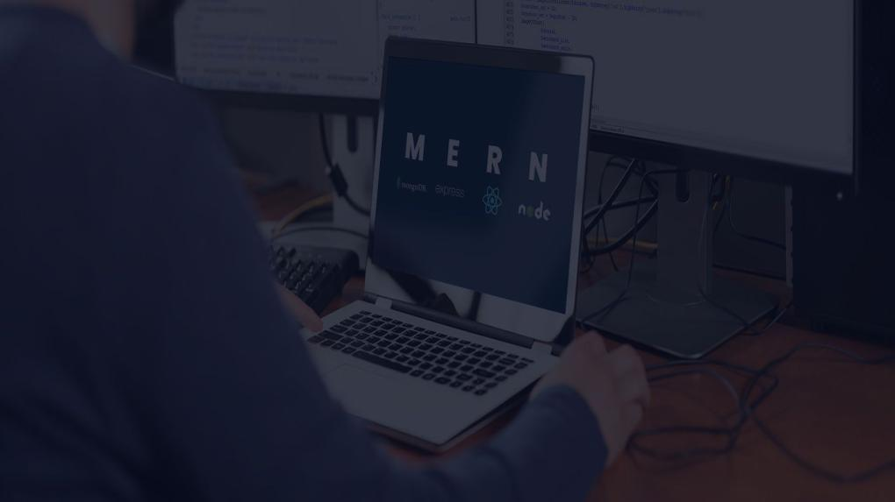
HOSPITAL Management System​ USING MERN STACK
Name: B Sahithya
Reg No: 20MIC0007
Date: 17/10/2024

Slide 2
Overview
Introduction
Gaps identified
Objectives
Problem Statement
Project Plan
Proposed Architecture
Technologies to be used
Reference Links

Slide 3
introduction
A hospital management system (HMS) is a comprehensive software solution designed to streamline and automate various administrative, clinical, and financial processes within a healthcare facility.
It incorporates a number of healthcare administration functions, such as prescription management, medical inventory management, doctor scheduling, and patient visits.
By digitizing and automating administrative and clinical tasks, an HMS improves the efficiency, accuracy, and quality of healthcare services.

Slide 4
introduction...
This HMS is built using the MERN stack—a combination of MongoDB, Express.js, React, and Node.js. Every element in the stack is essential to creating a cutting-edge, adaptable, and data-driven hospital management system.
The MERN stack is widely used for developing full-stack web applications due to its flexibility, scalability, and efficiency.
Each component of the stack plays a crucial role in building a modern, responsive, and data-driven hospital management solution

Slide 5
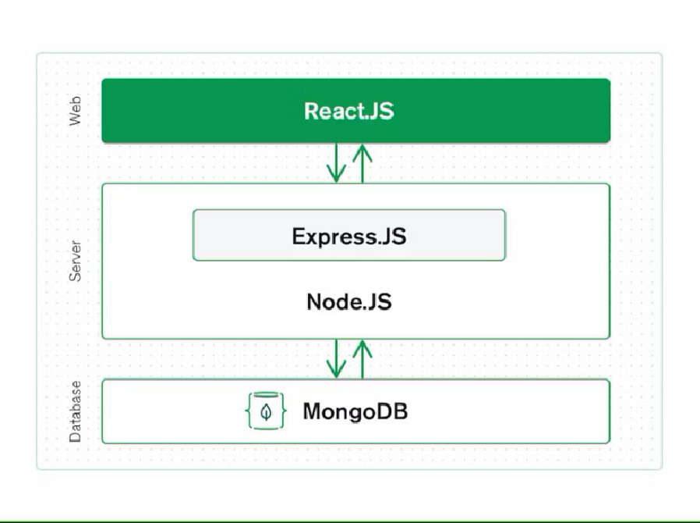
Working of MERN Stack

Slide 6
gaps identified
The system may not be accessible to individuals with limited internet access or technological proficiency [4].
The system’ s reliability in accurately directing patients to the right department based on their symptoms might be a challenge, especially if the symptoms are complex or require in-person evaluation [5].
The responsive of the application needs to be implemented to boost the application performance and to increase the availability of the website [5].
Scalability to real world hospital scenario where large number of patients who want to access the application and requires complex scheduling requirements [7].

Slide 7
objectives
To integrate the MERN stack to enable scalability and flexibility, making it simple to integrate new features and expand the system in the future.
To increase efficiency in administration by providing resources for tracking inventory, scheduling appointments, checking doctor availability, and creating hospital reports.
To improve patient care by providing a simple user friendly interface to the patients to schedule appointments, read prescriptions, and access medical data.
To enable real-time data access for doctors, admins, and patients, ensuring fast access to the website.

Slide 8
problem statement
Ineffective manual processes in hospitals lead to mistakes, increased waiting times, and operational obstacles, affecting appointment management, medication tracking, and inventory control. Doctors struggle with resource management, while patients face difficulties in scheduling appointments and accessing medical records. Hospital administrators are burdened with manual tasks, impacting patient care quality and operational efficiency. Therefore, a comprehensive, web-based Hospital Management System (HMS) using the MERN stack is essential to automate key functions, improve efficiency, and enhance patient care while ensuring data security and scalability.

Slide 9
project plan
Phase 1: Project planning and brainstorming (July)
Phase 2: Review 0 and Literature Survey (August)
Phase 3: Finding gaps in literature survey (September)
Phase 4: Proposed Architecture and Review 1 (October)
Phase 5: Installing packages and Frontend Implementation (November)
Phase 6: Backend Implementation (December)
Phase 7: Review 2 (January)
Final Phase: Review 3 (February)

Slide 10
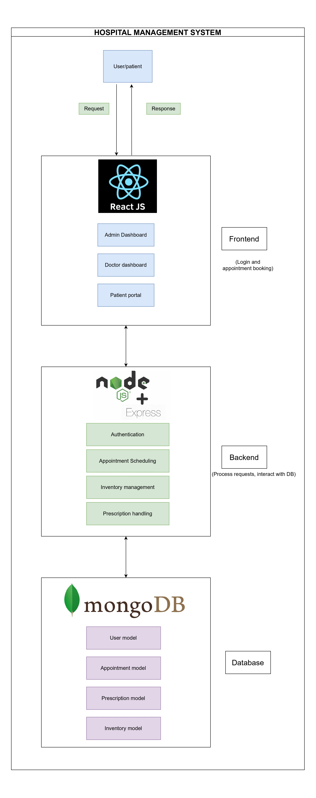
proposed architecture

Slide 11
technologies to be used
MongoDB
Express.js
React.js
Node.js
Dotenv
Bootstrap

Slide 12
reference links
Github Repository Link
https://github.com/Sahithya132002/Final-Year-Project

Slide 13
thank you

